Slide 1

HOTEL RESERVATION ANALYSIS WITH SQL
by
SAI PHANI KUMAR CHINTA
Batch – MIP-DA-10
01

Slide 2
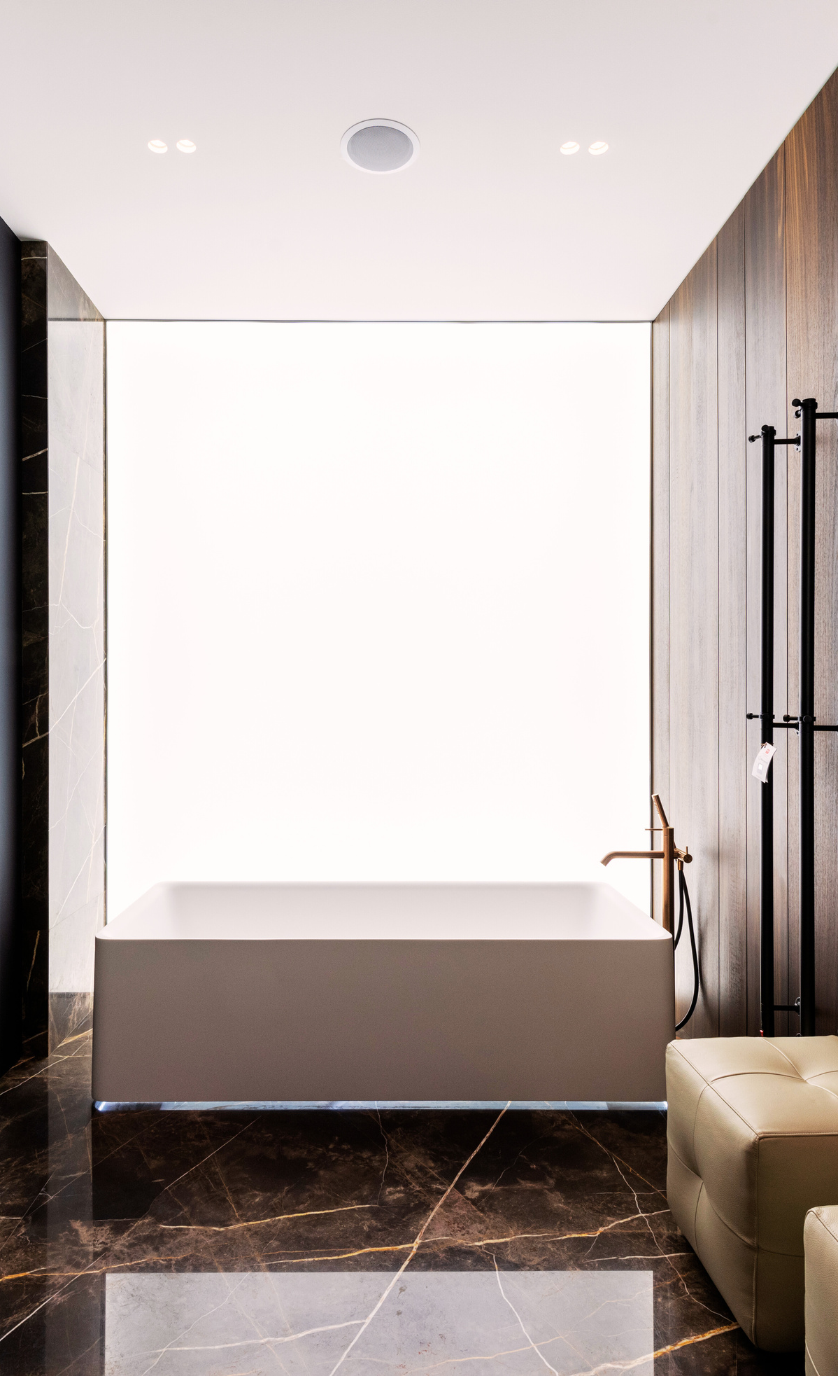
PROJECT OVERVIEW
The hotel industry relies on data to make informed decisions and provide a better guest experience.
The main objective is to perform Exploratory Data Analysis on the Hotel dataset to find the insights about the guest preferences, booking trends & other key factors influence hotel operations
In this task i will be using MySQL Database Management system tool to analyze the data and answer the questions about dataset
02

Slide 3
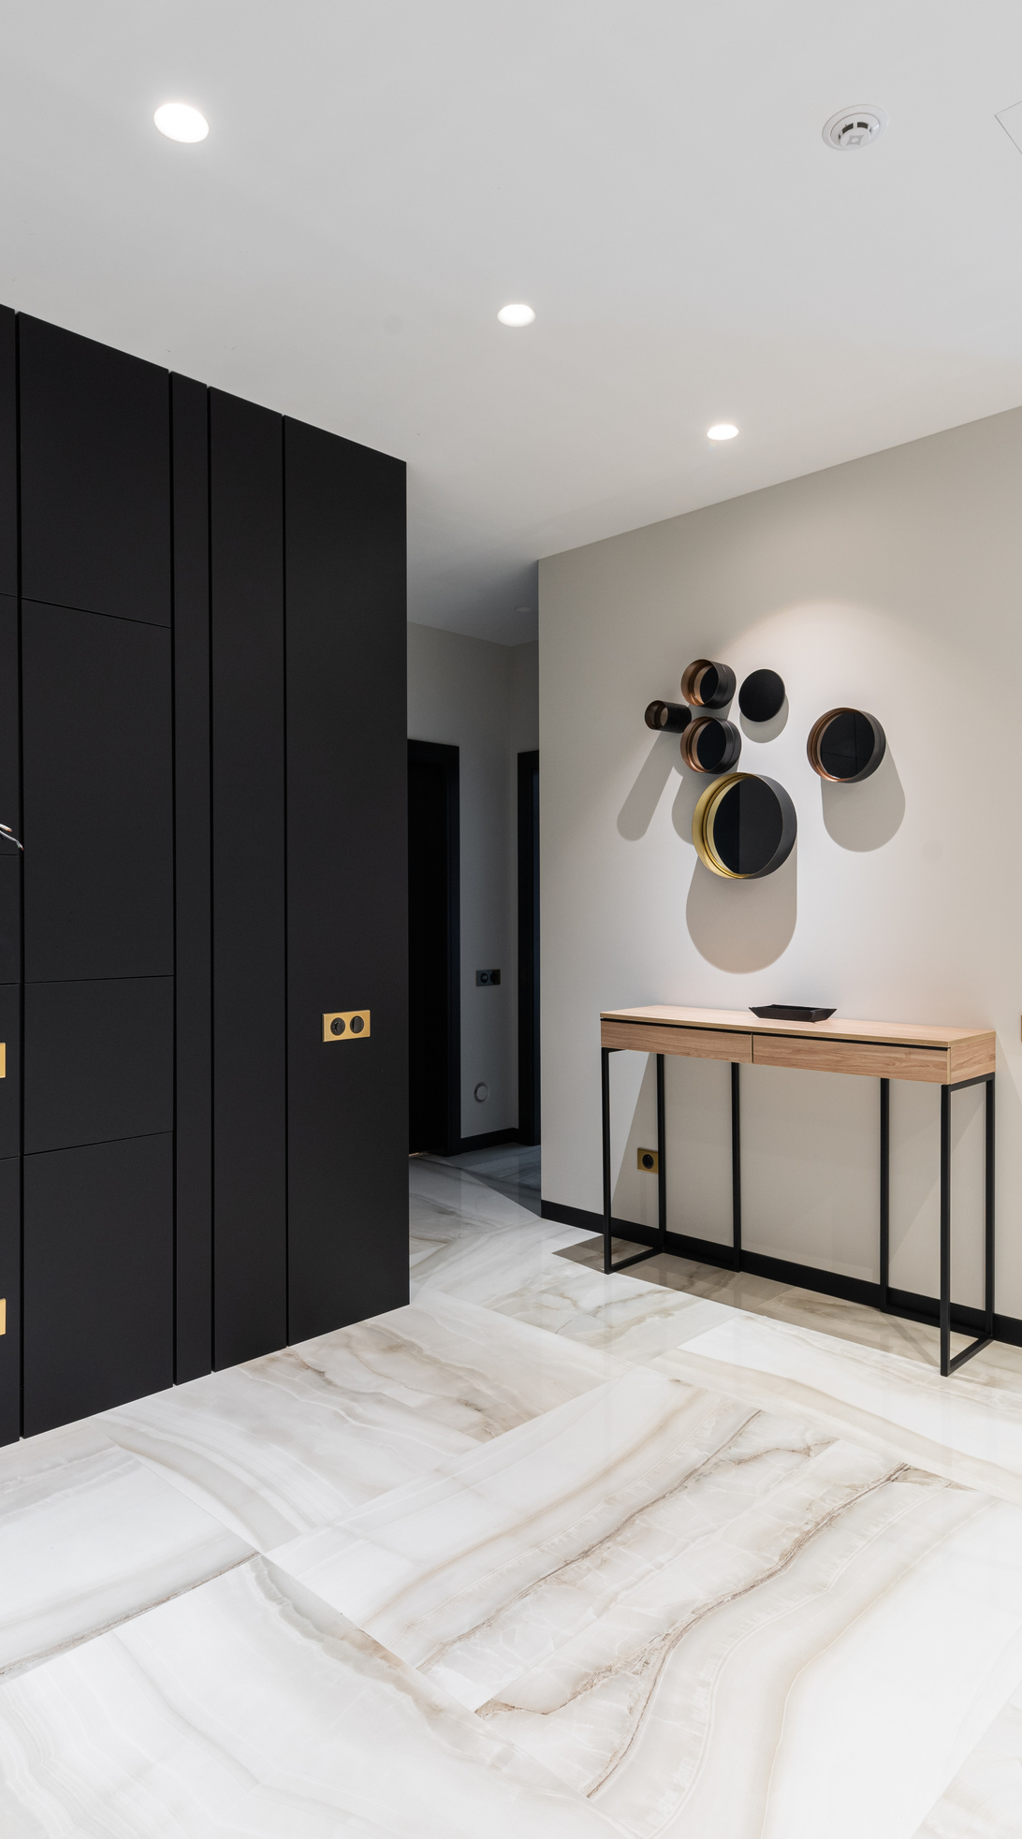
DATASET DETAILS
The dataset includes the following 12 features:
Booking_ID: A unique identifier for each hotel reservation.
no_of_adults: The number of adults in the reservation.
no_of_children: The number of children in the reservation.
no_of_weekend_nights: The number of nights in the reservation that fall on weekends.
no_of_week_nights: The number of nights in the reservation that fall on weekdays.
type_of_meal_plan: The meal plan chosen by the guests.
room_type_reserved: The type of room reserved by the guests.
lead_time: The number of days between booking and arrival.
arrival_date: The date of arrival.
market_segment_type: The market segment to which the reservatio belongs.
avg_price_per_room: The average price per room in the reservation.
booking_status: The status of the booking.
01
03

Slide 4

EDA QUESTIONS
1. What is the total number of reservations in the dataset?
2. Which meal plan is the most popular among guests?
3. What is the average price per room for reservations involving children?
4. How many reservations were made for the year 2018?
5. What is the most commonly booked room type?
6. How many reservations fall on a weekend (no_of_weekend_nights > 0)?
7. What is the highest and lowest lead time for reservations?
8. What is the most common market segment type for reservations?
9. How many reservations have a booking status of "Confirmed"?
10. What is the total number of adults and children across all reservations?
11. What is the average number of weekend nights for reservations involving children?
12. How many reservations were made in each month of the year?
13. What is the average number of nights (both weekend and weekday) spent by guests for each room type?
14. For reservations involving children, what is the most common room type, and what is the average price for that room type?
15. Find the market segment type that generates the highest average price per room.
04

Slide 5
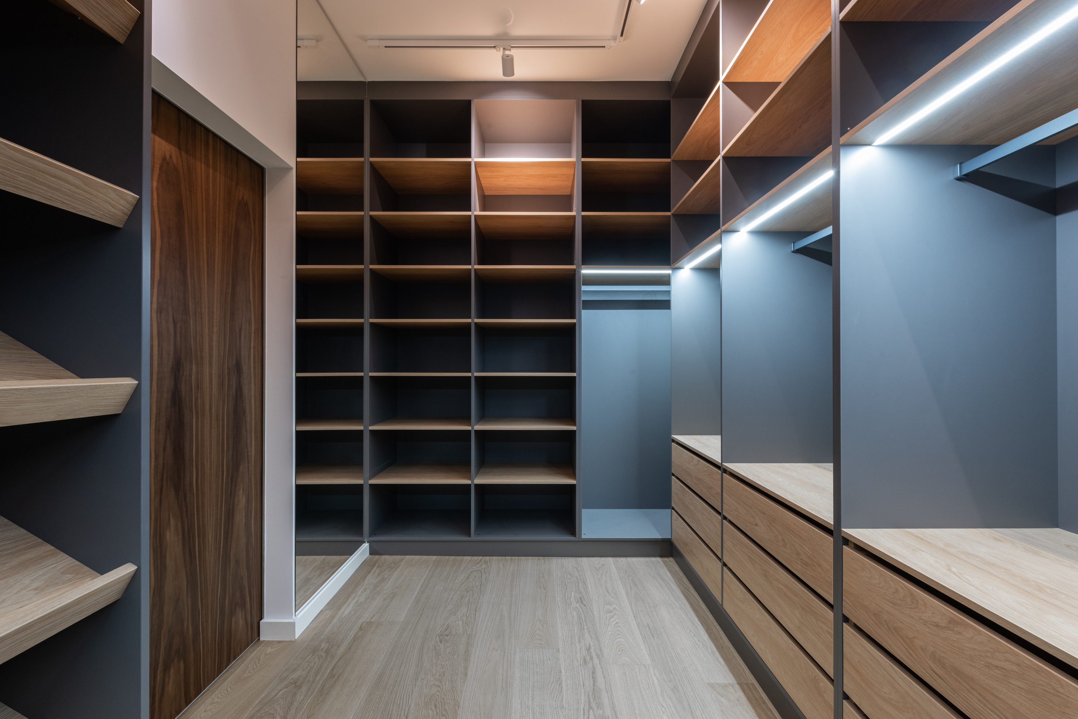

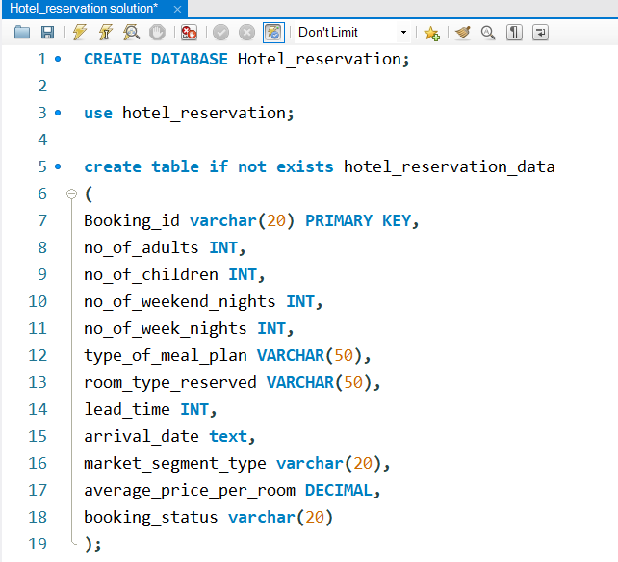
DATABASE & TABLE CREATION
QUERY
05

Slide 6
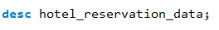
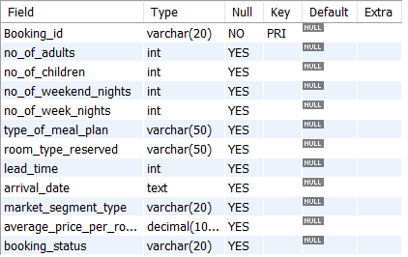
SCHEMA STRUCTURE
QUERY
RESULT
06

Slide 7
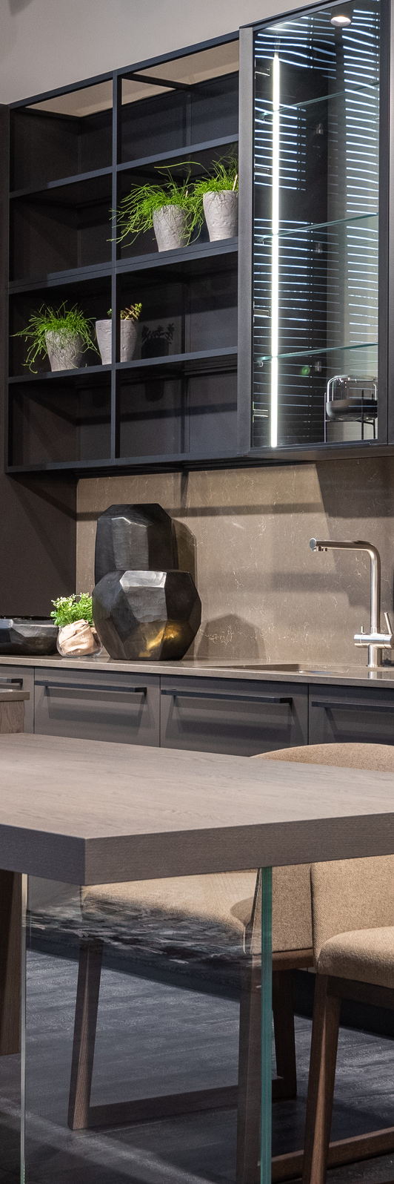
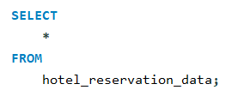
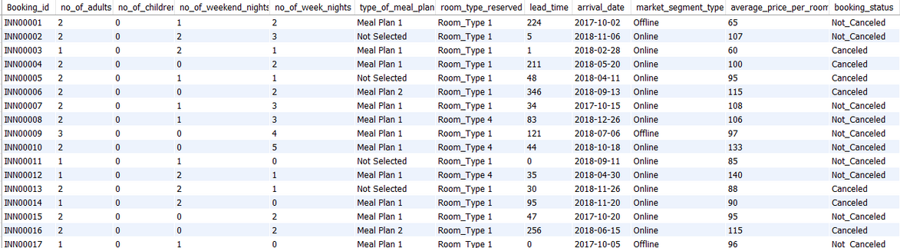
IMPORTED DATASET INTO MYSQL
QUERY
RESULT
07

Slide 8
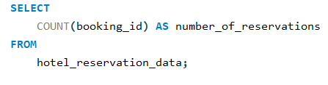
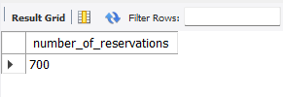
DATA QUERYING
1. What is the total number of reservations in the dataset?
QUERY
RESULT
08

Slide 9
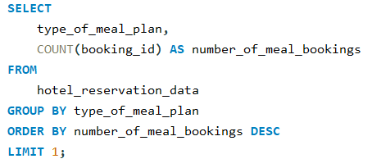
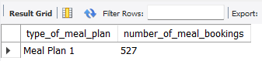
2. Which meal plan is the most popular among guests?
QUERY
RESULT
09

Slide 10
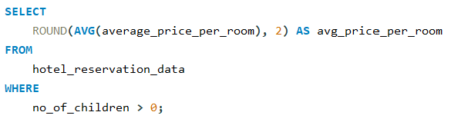
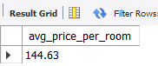
3. What is the average price per room for reservations involving children?
QUERY
RESULT
10

Slide 11
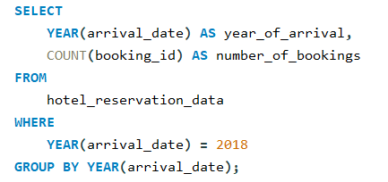
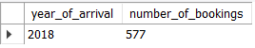
4. How many reservations were made for the year 2018?
QUERY
RESULT
11

Slide 12
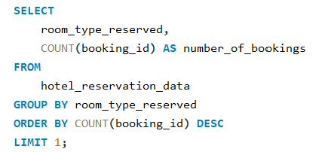
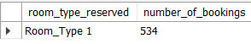
5. What is the most commonly booked room type?
QUERY
RESULT
12

Slide 13
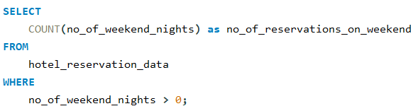
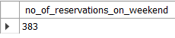
6. How many reservations fall on a weekend (no_of_weekend_nights > 0)?
QUERY
RESULT
13

Slide 14
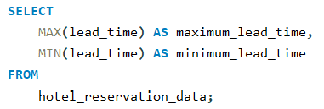
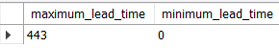
7. What is the highest and lowest lead time for reservations?
QUERY
RESULT
14

Slide 15
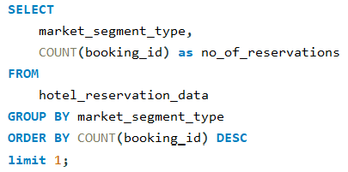
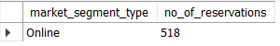
8. What is the most common market segment type for reservations?
QUERY
RESULT
15

Slide 16
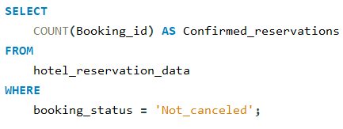
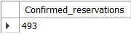
9. How many reservations have a booking status of "Confirmed"?
QUERY
RESULT
16

Slide 17
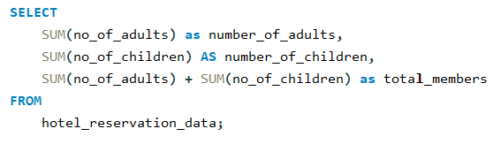
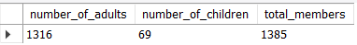
10. What is the total number of adults and children across all reservations?
QUERY
RESULT
17

Slide 18
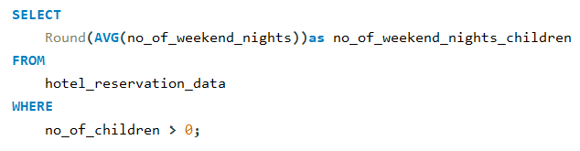
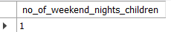
11. What is the average number of weekend nights for reservations involving children?
QUERY
RESULT
18

Slide 19
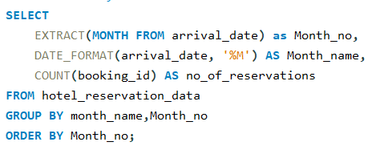
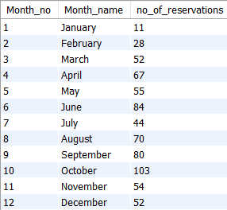
12. How many reservations were made in each month of the year?
QUERY
RESULT
19

Slide 20
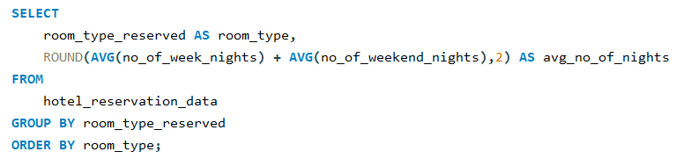
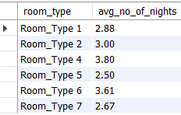
13. What is the average number of nights (both weekend and weekday) spent by guests for each room type?
QUERY
RESULT
20

Slide 21
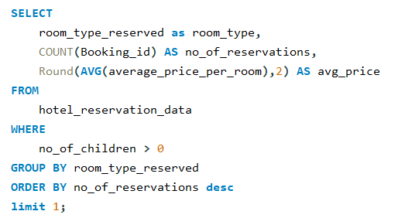
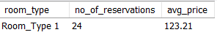
14. For reservations involving children, what is the most common room type, and what is the average price for that room type?
QUERY
RESULT
21

Slide 22
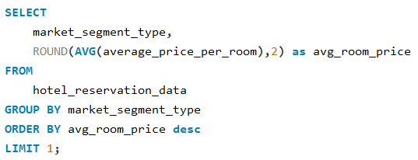
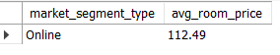
15. Find the market segment type that generates the highest average price per room.
QUERY
RESULT
22

Slide 23
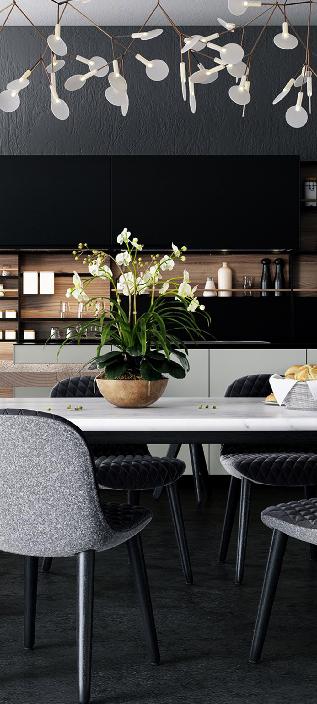
THANK YOU
23

